Slide 1
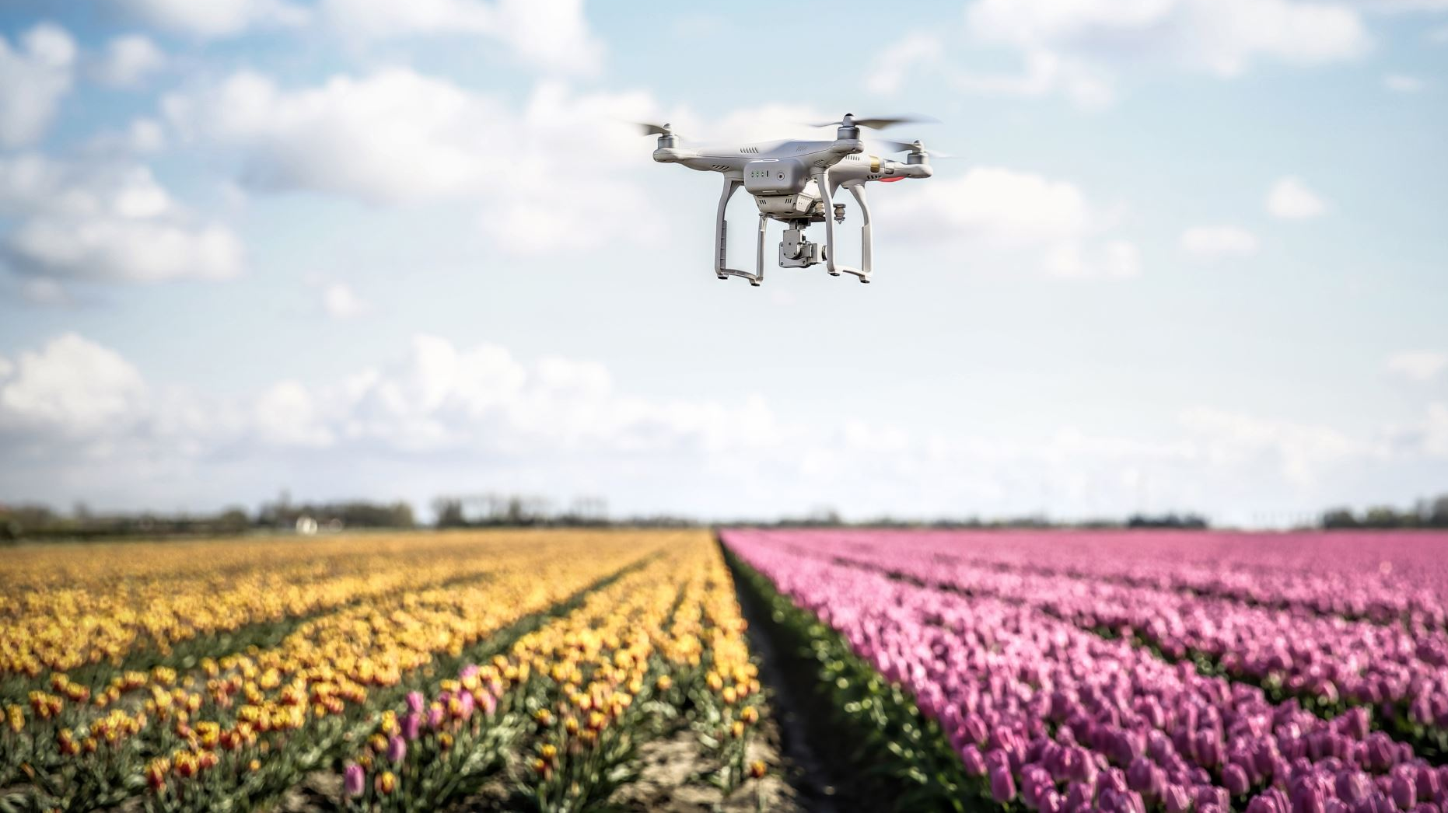
Cost – Benefit Analysis of Drone Delivery System
Presented by Deepanshu Bisht
09/04/23

Slide 2
Proposed Delivery Model
For distance less than 3 km, orders executed completely by delivery executive
For distance greater than 4 km, orders executed by delivery executive 1, drone, and delivery executive 2.
For distance between 3 and 4 km, either of the above two delivery model could be opted depending upon the optimized route and delivery time.
In the current scenario, we are assuming delivery of orders greater than 3 km to be executed by hybrid drone delivery model.

Slide 3
Daily Fixed Expenses
Average Monthly Order | 7,000,000
Bangalore@24% | 1,680,000
Average Delivery by one delivery boy | 425
Total no. of delivery executive | 3952.941176 | Month Starting
Attrition @10% | 395.2941176
Delivery executive remaining | 3557.647059 | Month Ending
Delivery executives at any given point of time | 3755
Fixed Component(Monthly Basis)
Total Delivery executives | 3755
Fixed Salary per delivery executive | ₹4,000
Total Fixed Salary per month | ₹15,021,176
Total Fixed Salary per year | ₹180,254,118
Fixed Expenses per Day | ₹493,847

Slide 4
Daily Variable Expenses
Total Delivery executives | 3755
Average Delivery per executive | 425
Earnings on each successful delivery | ₹55
Variable earnings per delivery executive | ₹23,375
Total Variable Pay | ₹87,780,000
Variable pay per day | ₹2,885,918

Slide 5
Revenue in Current Model
Average daily Orders | 56,000
Revenue Per Order | ₹70
Average Monthly Orders | 1,680,000
Revenue per day | ₹3,920,000

Slide 6
Cost – Benefit Analysis in Current Model
Revenue per day | ₹3,920,000
Total Pay per day | ₹3,379,765
Per day margin | ₹540,235
CBA
Expenses as a pecentage of revenue | 86.22%
Margin as a pecentage of revenue | 13.78%

Slide 7
Available Data and Considerations
Urban Area of Bangalore to be covered – 741 sq. km.
25 percent complaints are regarding late delivery
Avg life expectancy of drone – 3 years
Avg drone speed – 40 km/h
Avg distance covered by drone in single charge – 7-8 km

Slide 8
Assumptions
Area of about 600 sqft required for each Drone Base.
Avg Distance between two Drone Bases is 3.5 km
1 Drone operator - per 10 drones
1-2 Drone assistants - per drone base
Drone base setup cost - 2,00,000 per unit
Monthly miscellaneous expenses including electricity - 20,000
Avg monthly rent per drone base – 50,000
Total 4 Air Traffic Controller required

Slide 9
Daily Fixed Expenses in Proposed Model
Total Cost Of 168 Drone Purchase(1,30,000 per drone) |  | ₹21,840,000
Annual Cost Of Drone Purchases (Life expectancy 3 years) |  | ₹7,280,000
Annual battery requirement( 3 per drone per quarter) | 2,016
Annual Battery expenditure for 2016 batteries(13,000 per battery) |  | ₹26,208,000
Total yearly maintenance cost of 168 drones (78,000 per drone) |  | ₹13,104,000
Setup cost for 121 drone pads(2,00,000 per drone pad) | ₹24,200,000
Per year infrastructure setup cost ( considering over 3 years) |  | ₹8,066,667
Initial Drone integration setup cost |  | ₹5,000,000
Annual Fixed pay for delivery executives |  | ₹69,024,000
Annual Investment Cost(fixed) |  | ₹128,682,667
Number Of operational days |  | 365
Daily Investment Cost(Fixed) |  | ₹352,555

Slide 10
Daily Variable Expenses in Proposed Model
Variable |  | Total
annual salary of 17 Drone Operators(4,00,000 per year) |  | ₹6,800,000
Yearly rent of 121 Drone pad units |  | ₹72,600,000
Total Annual Salary of 182 Assistants(3,00,000 per year) |  | ₹54,600,000
Miscellaneous Expenses & Electricity Consumption for a year |  | ₹29,040,000
Variable pay for Delivery Executves |  | ₹604,800,000
Total Variable of per Air Traffic Controller |  | ₹4,000,000
Annual variable pay |  | ₹771,840,000
Number Of operational days |  | 365
Per Day Variable Cost |  | ₹2,114,630

Slide 11
Cost – Benefit Analysis in Proposed Model
Per Day Basis
Total Expenses(Fixed+ Variable) | ₹2,467,185
Revenue | ₹3,920,000
Margin | ₹1,452,815
CBA
Expenses as a pecentage of revenue | 62.94%
Margin as a pecentage of revenue | 37.06%
Profit(no. of times) | 2.69
Expenses(no. of Times) | 0.73

Slide 12
Scope and Conclusion
Margin has increased from 13.78 percent to 37.06 percent
With advancement in drone technology, expected in upcoming years, we expect to decrease the operational cost of drone along with increased efficiency, and thus profit.
With increase in serviceable distance, we expect an increase in number of orders, resulting in more revenue in profit.

